Slide 1
Children in the climate crisis

Slide 2

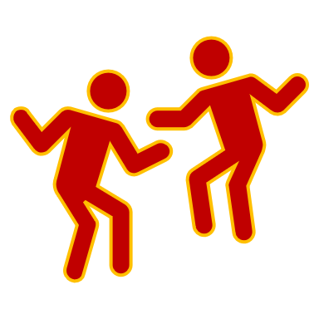
Children in the climate crisis
We got it!!!!

Slide 3

Consortia project
ERASMUS+ consortia partnership:
Partnerships to enhance the internationalization of the participating institutions and to create high-quality and transferable outcomes.
Dissemination of results at the local, regional, national, and European levels.
Relevance of the project for school education.
Consortium Principle: Responsibility of the coordinating institution for financial and administrative coordination.
Duration: 3 years (September 2023 to August 2026)
→ All details tomorrow
Notes:
Erasmus+ ist das EU-Programm für allgemeine und berufliche Bildung, Jugend und Sport. Die Förderung der europaweiten Zusammenarbeit in allen Bildungsbereichen ist ein wichtiges Anliegen der Europäischen Union. Auf dem Weg zu einem gemeinsamen Eu
In einer Kooperationspartnerschaft können verschiedene Einrichtungen zu einem selbstgewählten Thema aus dem Schulbereich zusammenarbeiten, zum Beispiel Digitalisierung, Inklusion, Bildungsgerechtigkeit, Erzieherinnenausbildung, MINT-Förderung und mehr.

Slide 4
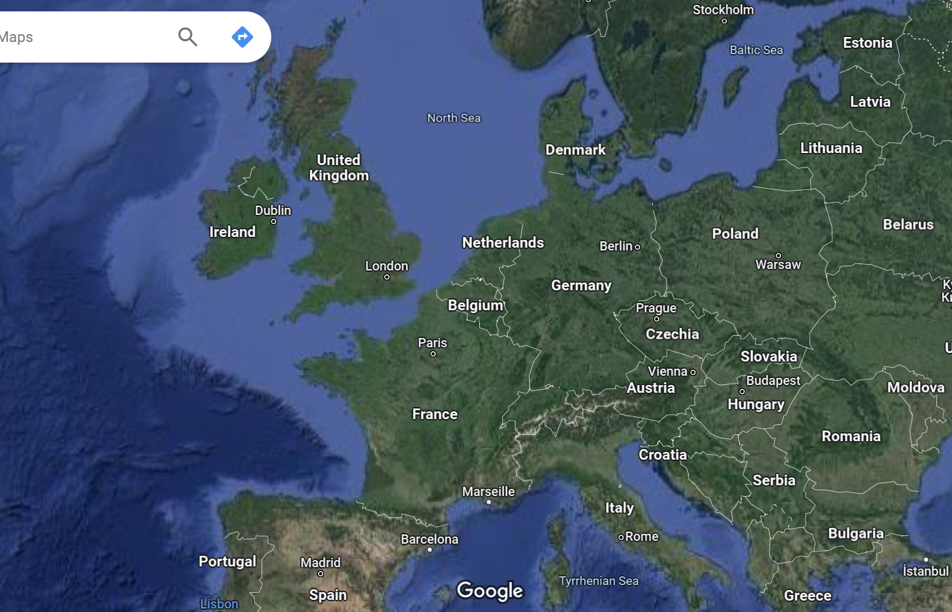
Partner of the project

Slide 5
Partner of the project
University Bonn, Institut for Geosciences, Meteorology department
EBK Köln
Fröbel Kita Eifelstr. , Köln

Slide 6
Partner of the project
Estonian Association of youth workers

Slide 7
Partner of the project
Porta del Parco, Anquillara

Slide 8
Partner of the project
Donegal Youth Service, Donegal

Slide 9
Partner of the project
Szkola Podstawawa Nr. 85, Gdansk

Slide 10
Partner of the project
Collegio Santa Ana, Fraga

Slide 11
Partner of the project
Eight partners from five European countries

Slide 12
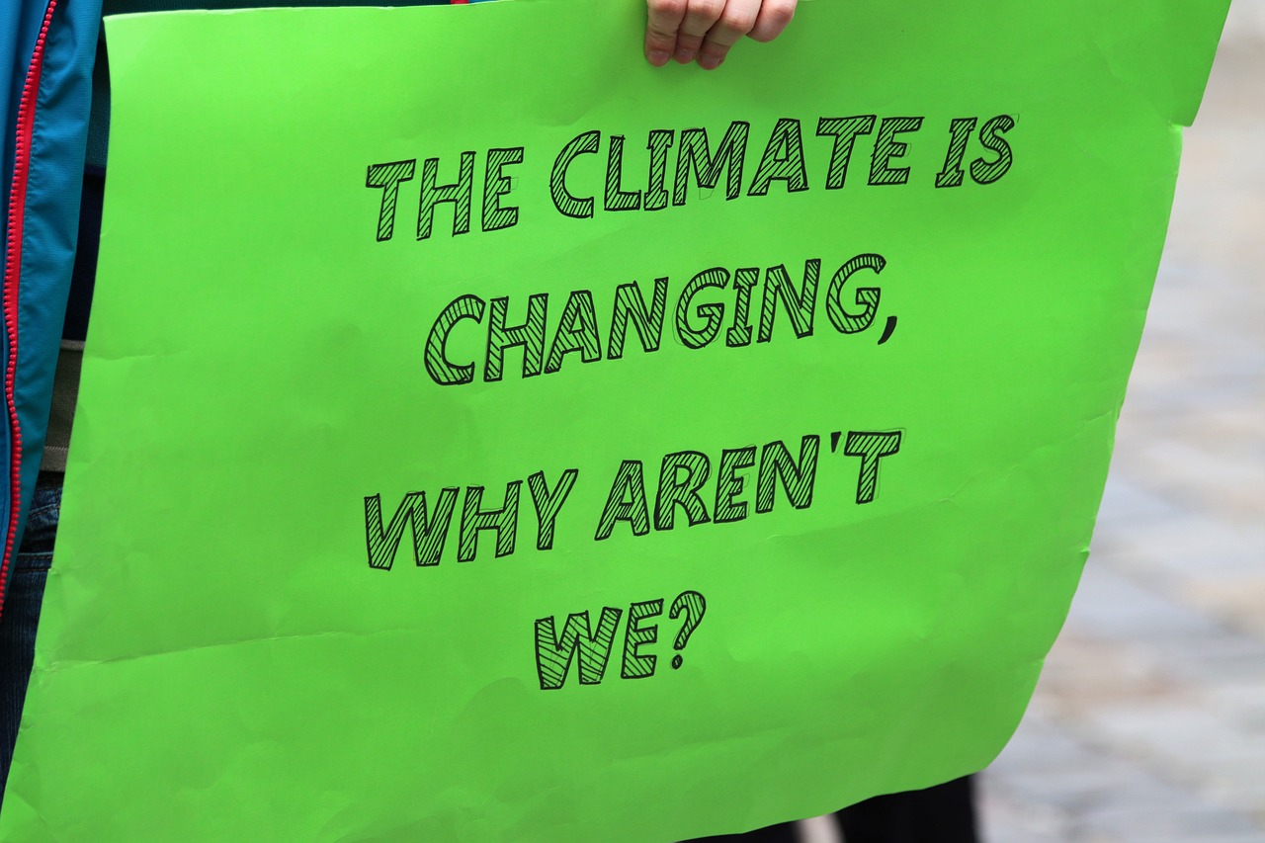

Slide 13

Aims of project
Project Objective:
Raising awareness among children, adolescents, educators, and future educators about climate change.
Mobilizing all stakeholders for concrete daily actions to combat climate change.
Teaching important skills with STEM is an example.
Europe
Political relevance/civic engagement

Slide 14

How to reach there?
Five Workpackages:
Management
Science and measurements
Climate protection planning: Visualization, ecological fFootprint
Anti Fake Kits
Constructive climate

Slide 15

Management
Structured framework, including legal mandates and a coordinated timeline.
Monitoring of project progress
Ongoing progress and activities are transparently shared on our website.
Communication via 5 in-person meetings and regular video meetings

Slide 16

Science and Measurements
Measure CO2 levels at European partner and follow-up institution locations.
Engage educators, children, and learners in assembling and conducting measurements.
Promote scientific literacy and responsibility.
Address the need for science education among primarily female educators.

Slide 17

Climate Protection Planning: Visualization, Ecological Footprint
Foster motivation for climate action among educators through scientific and educational support.
Increase climate-relevant competencies in educational institutions
Visualising of (own) measurements.
Utilize "warming stripes" for visualizing climate change and engage various age groups.

Slide 18

Anti Fake Kits
Address climate change deniers
Provide facts to counter various conspiracy theories related to climate change.
Empower educators and their students to resist these theories and protect themselves effectively.

Slide 19

Constructive climate
The creative exploration of climate protection:
climate stories
ecological recipes
Photos
Videos
mini-theater plays
….

Slide 20

Project outcome
Installed and mobile CO2 measurements at the different locations
Development of climate maps for the locations
Collection of ideas/actions and projects related to the topic
Website and book format
Establishment of a competition
Climate box
Warming stripes in public spaces

Slide 21
Kick-off meeting
 | Wednesday 27/09: Berufskolleg Cologne, Berrenrather Str. 121, 50937 Köln
10:00 - 10:15 | Welcoming
10:15 - 11:15 | Detailed Project presentation (tasks of partners, project meetings, time schedule, contracts, organisation)
11:15- 12:15 | Presentation of climate box
12:15 – 13:00 | Lunch
13:00 – 13:30 | Presentation of CO2 measurement instruments
13:30 - 15:00 | Walk with CO2 measurements
 | Thursday 28/09: Berufskolleg Cologne, Berrenrather Str. 121, 50937 Köln
10:00 – 12:00 | Fantasielab (visit + lunch)
12:00-15:00 | Planning of next project meeting in Fraga, Spain (topic: presentation of measurements – warming stripes → input presentation on warming stripes)
evening | Common dinner in Cologne Brewery

